Slide 1
Papers :
Image Style Transfer Using Convolutional Neural Networks in CVPR 2016
Authors: Leon A. Gatys,Alexander S. Ecker,Matthias Bethge
Texture Synthesis Using Convolutional Neural Networks in NIPS 2015
Authors: Leon A. Gatys,Alexander S. Ecker,Matthias Bethge
Arbitrary Style Transfer in Real-time with Adaptive Instance Normalization in ICCV 2017
Authors: Xun Huang,Serge Belongie

Slide 2
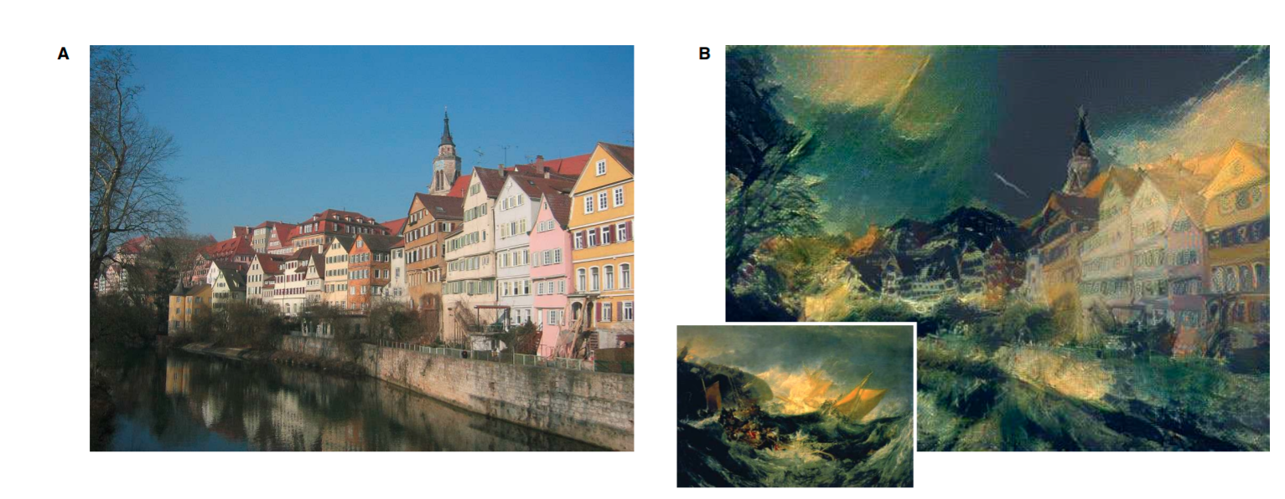
Image Style Transfer using Convolutional Neural Networks in CVPR 2016

Slide 3
Introduction
How we can render semantic of images?
We need a way to separate content and style.
Previous approaches lack image representations.

Slide 4
Solution given in this paper
We can use image representations derived from Convolutional Neural Networks optimised for object recognition.

Slide 5
Dataset
In,this paper there is no specific dataset mentioned as the authors have proposed an algorithm which runs on test time and does not require pre-training.

Slide 6
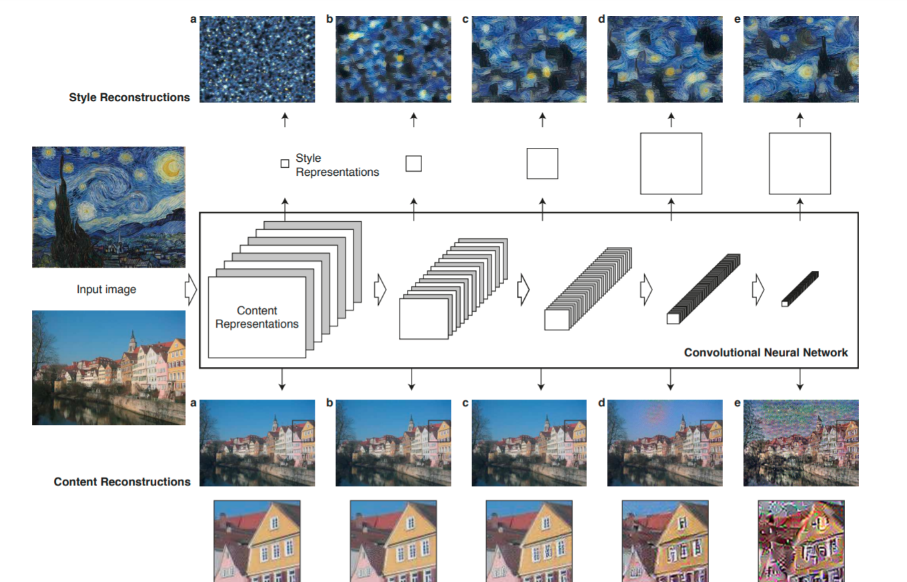
Some observations

Slide 7
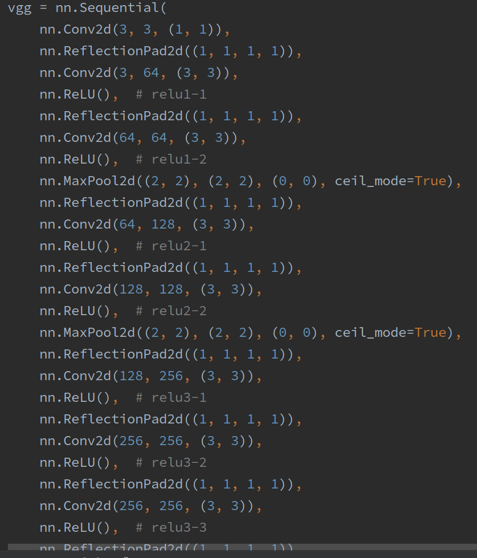
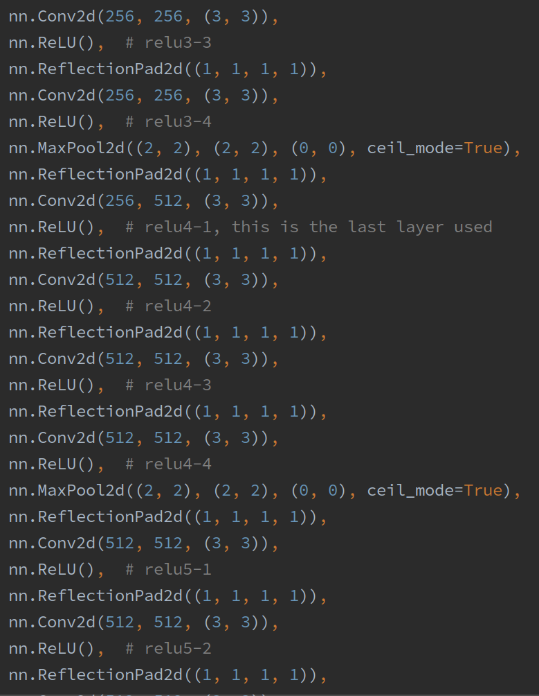

Slide 8
Used modified VGG19 Network
They normalized the network by scaling the weights such that the mean activation of each convolutional filter over images and positions is equal to one.
Replacing max-pooling with average pooling improves gradient flow.Images generated are cleaner.

Slide 9
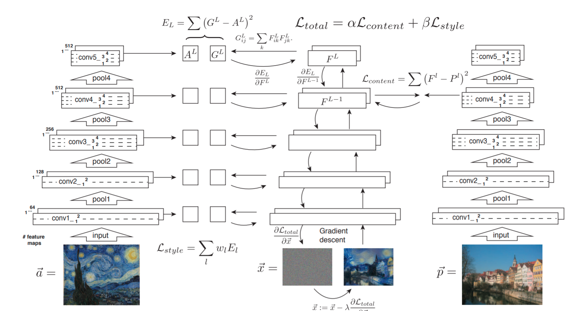

Slide 10
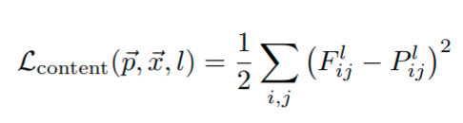
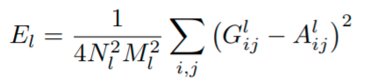
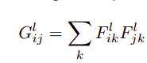
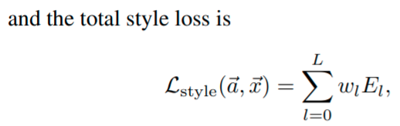
Losses used in training
Content Loss
F,P are the feature maps of images p,x
2. Style Loss of a layer
Contribution of layer l in style loss

Slide 11
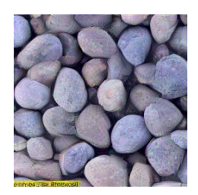
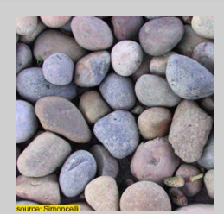
Texture Synthesis Using Convolutional Neural Networks in NIPS 2015
In,this paper authors are trying to generate a texture from a given example texture.
Original
Generated
Notes:
Novelty in this paper is that they are producing textures based on the features spaces of convolution neural network.

Slide 12
Main Approaches for Texture Generation
Generate new texture by resampling of pixels or whole patches.This is non-parametric approach.Do not define an actual model for generating textures.Use mechanistic procedure without changing its perceptual properties.
Define a parametric texture model.This paper used this approach.

Slide 13
Advantage of using parametric approach of CNN
Since,CNN is spatially invariant due to training on object recognition we get a texture model which is also spatially invariant.

Slide 14
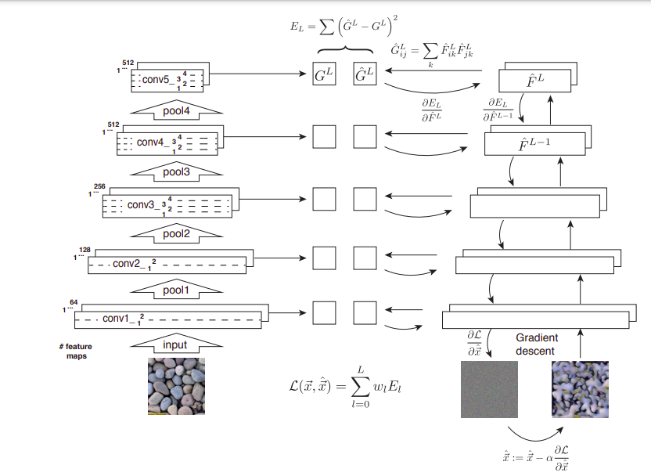
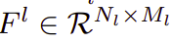
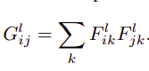
Each Layer of CNN has N_{l} feature maps of size M_{l} when vectorized.So,
F^{l}_{jk} is the activation of the j^{th} filter at position k in layer l.
In,this method texture is learnt using feature correlations.It is given by Gram matrix.

Slide 15
Here,Optimization done for Gram matrix by minimizing the mean-squared distance between its entries.
They consider all the intermediate layers Gram matrix representation for this.
L-BFGS is used to learn the correct representation for the white noise image.
Notes:
Here,we consider a random white noise image.By,using gradient descent we optimize the Gram matrix of white noise image and the example image at different layers. optimisation is done by minimising the mean-squared distance between the entries of the Gram matrix of the original image and the Gram matrix of the image being generated.

Slide 16
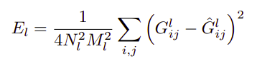
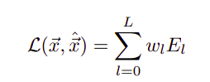
Contribution of a layer in loss function:
Total loss is:
w_{l} is hyperparam
Notes:
Here,we consider a random white noise image.By,using gradient descent we optimize the Gram matrix of white noise image and the example image at different layers. optimisation is done by minimising the mean-squared distance between the entries of the Gram matrix of the original image and the Gram matrix of the image being generated.

Slide 17
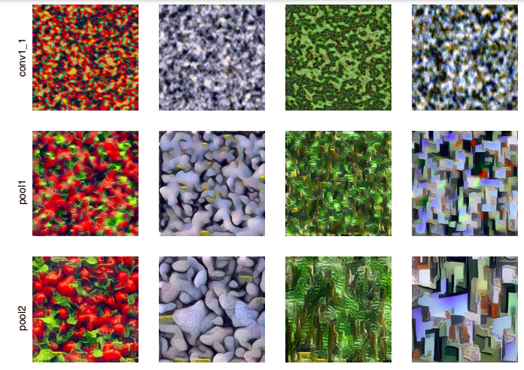
Results

Slide 18
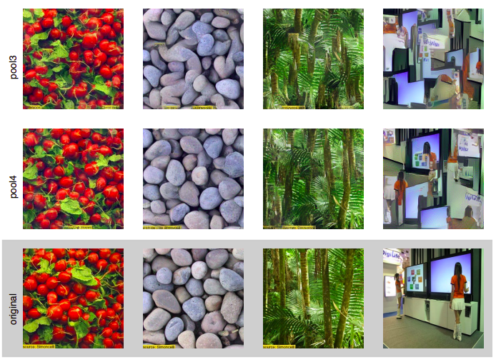

Slide 19
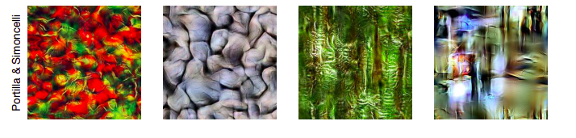

Slide 20
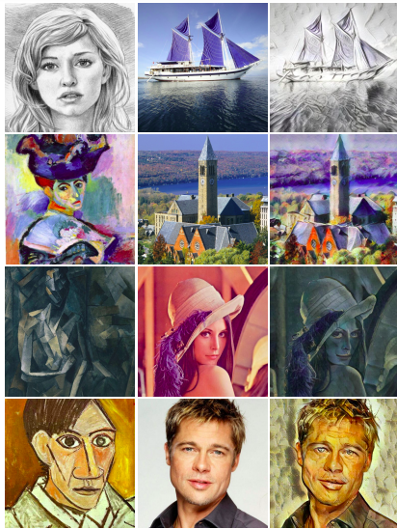
Arbitrary Style Transfer in Real-time with Adaptive Instance Normalization in ICCV 2017

Slide 21
Introduction
Present a simple effective approach for the first time that enables arbitrary style transfer in real-time.
Propose a novel Adaptive Instance Normalization(AdaIN) layer that aligns the mean and variance of content features with style features.
Before this,most feed-forward methods each network is restricted to a single style.

Slide 22
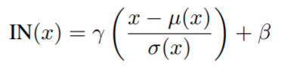
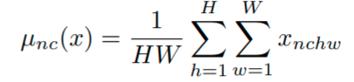
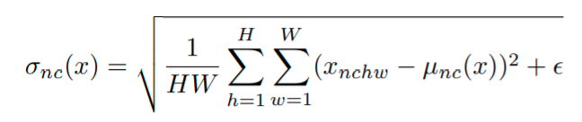
Instance Normalization(IN)
ᵧ,ᵦ ϵ ℝ^{C} are affine parameters learned from data.
Mean and variance are calculated for each channel and each sample.
Observation 1: Affine parameters γ and β in IN can completely change the style of the output image.
Observation 2: Matching many other statistics,including channel-wise mean and variance are also effective for style transfer

Slide 23
Argument by the author
Instance normalization performs a form of style normalization by normalizing feature statistics, namely the mean and variance.

Slide 24
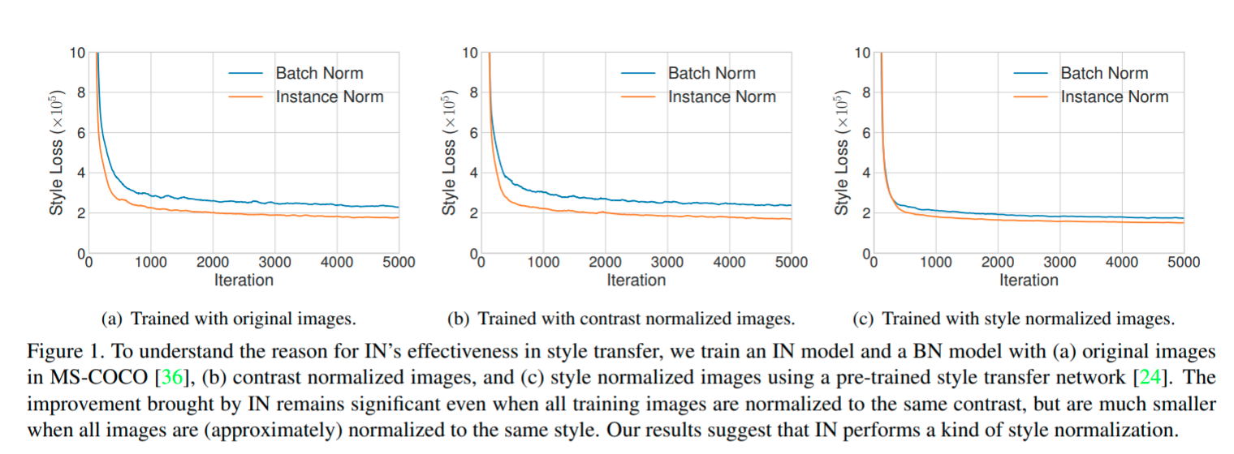

Slide 25
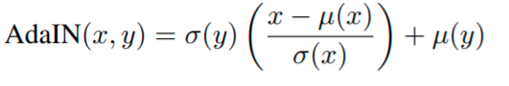
Adaptive Instance Normalization
Question Asked: If IN normalizes the input to a single style specified by the affine parameters,is it possible to adapt it to arbitrary given styles by using adaptive affine transformation?
Answer is the AdaIN layer.It takes a content input x and style input y and simply aligns the channel-wise mean and variance of x to match those of y.
x is content image,y is style image.Mean and variance are calculated same as the IN.

Slide 26
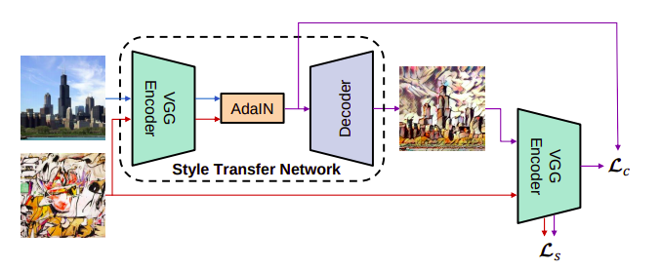
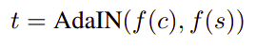
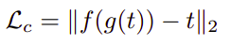
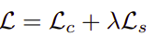
f is encoder,g is decoder
Content Loss
Overall Loss

Slide 27
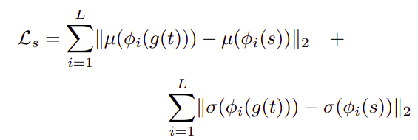
Style Loss
Φ_{i} is i^{th} relu layer

Slide 28
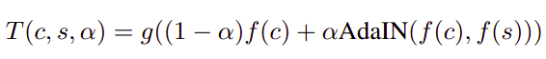
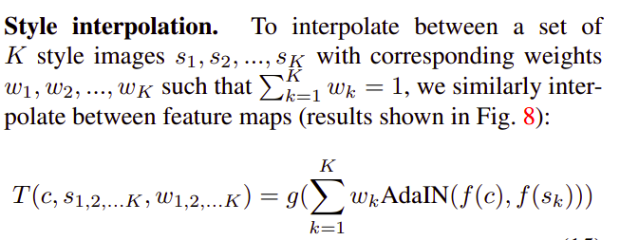
Control of degree of style transfer
Provides content-style tradeoff at test-time by interpolating between feature maps that are fed to the decoder.Equivalently, interpolating between the affine parameters of AdaIN.

Slide 29
Dataset Used
MS-COCO dataset for content images.
Wikiart dataset for style images.
Each contains around 80K training images which were used by the authors for there model training.

Slide 30
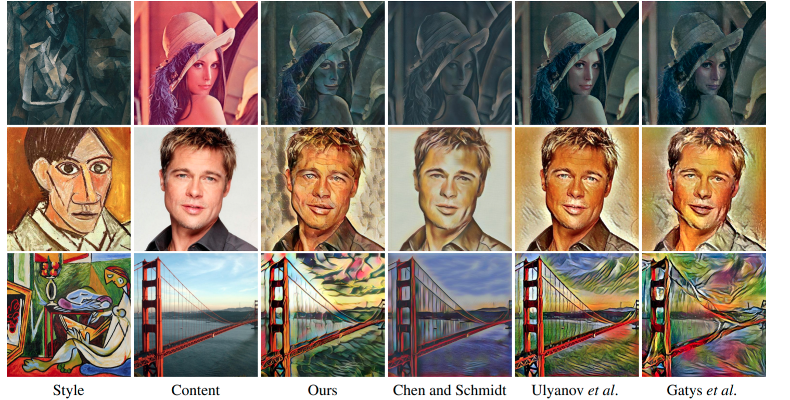

Slide 31
